Slide 1
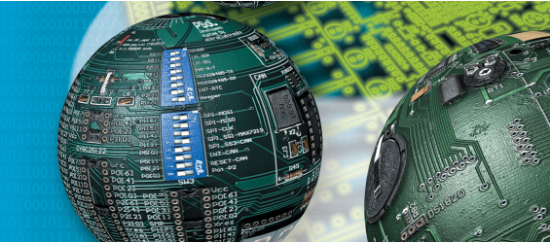
Embedded Systems I/O of TM4C123HG6PM (contd)
Fall 2018
NUCES – FAST

Slide 2
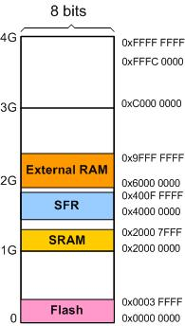
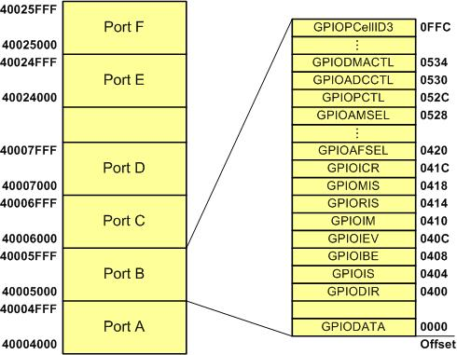
Memory Mapping (revisited)
Base address

Slide 3
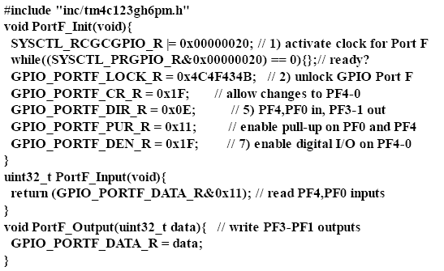
Example

Slide 4
Exercise: Toggle Blue LED with SW1
#include <stdio.h>
#include "inc/tm4c123gh6pm.h"
#define SW1 (GPIO_PORTF_DATA_R&0x10)
void PortF_Init(void){
SYSCTL_RCGCGPIO_R |= 0x00000020; // activate clock for Port F
while((SYSCTL_PRGPIO_R&0x00000020) == 0){};// ready?
GPIO_PORTF_LOCK_R = 0x4C4F434B; // unlock GPIO Port F
GPIO_PORTF_CR_R = 0x14; // allow changes to PF2 & PF4
GPIO_PORTF_DIR_R = 0x04; // PF4 in, PF2 out
GPIO_PORTF_PUR_R = 0x10; // enable pull-up on PF4
GPIO_PORTF_DEN_R = 0x14; // enable digital I/O on PF2 & PF4}
void main(void)
{PortF_Init();
while(1){
if (!SW1)
GPIO_PORTF_DATA_R=GPIO_PORTF_DATA_R^0x04;
}
}

Slide 5
Reading/writing to individual pins of ports
In order to modify single bit of a port, we must not modify other pins
Two methods are used
Read-modify-write method
Using masking concept, AND / OR operations
In order to make bit 5 of PORTF 1 without affecting other bits,
PORTF_DATA_R= PORTF_DATA_R | 0x20
Bit Specific Addressing
Contd. on next slide

Slide 6
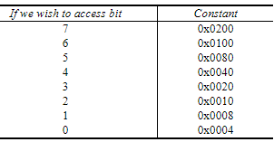
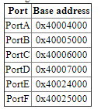
Bit Specific Addressing
if we are interested in bit b, the constant is 4*2^{b}
There are 256 possible bit combinations we might be interested in accessing, from all of them to none of them.
Each possible bit combination has a separate address for accessing that combination. For each bit we are interested in, we add up the corresponding constants from this Table and then add that sum to the base address for the port.
For example, assume we are interested in Port A bits 1, 2, and 3. The base address for Port A is 0x4000.4000, and the constants are 0x0008, 0x0010, and 0x0020. The sum of 0x4000.4000+0x0008+0x0010 +0x0020 is the address 0x4000.4038. If we read from 0x4000.4038 only bits 1, 2, and 3 will be returned. If we write to this address only bits 1, 2, and 3 will be modified.
#define PA123 *((volatile uint32_t *)0x40004038)
..
PA123=0x0A; //only bits 1,2,3 will be updated, rest will be same

Slide 7
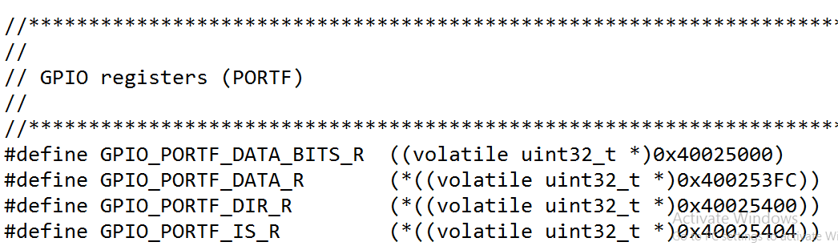
Bit Specific Addressing (contd.)
To update complete port, add all the offsets to base address
Example
PORTF = 0x40025000 + all values = 0x400253FC
That’s why in header file, we have this address against PORTF_DATA_R

Slide 8
Example
#define LED *((volatile uint32_t *) 0x40025008)
void PortF_Init(void){
SYSCTL_RCGCGPIO_R |= 0x00000020; // 1) activate clock for Port F
while((SYSCTL_PRGPIO_R&0x00000020) == 0){};// ready?
GPIO_PORTF_LOCK_R = 0x4C4F434B; // 2) unlock GPIO Port F
GPIO_PORTF_CR_R = 0x02;
GPIO_PORTF_DIR_R = 0x02;
GPIO_PORTF_PUR_R = 0x11;
GPIO_PORTF_DEN_R = 0x02;
}
void delay()
{
uint32_t counter=0;
for (counter=0; counter<200000;counter++);
}
void main(void)
{ PortF_Init();
while(1) {
LED=LED ^ 0x02;
delay();} }

